Slide 1
Sentiment Analysis on IMDB Dataset
By Maimoona Khilji

Slide 2
TABLE OF CONTENTS
A
Sentiment Analysis
B
Multi Layer Perceptron
C
IMDB Dataset
D
Practical Implementation in Python

Slide 3

Sentiment analysis
Sentiment analysis studies the subjective information in an expression, that is, the opinions, appraisals, emotions, or attitudes towards a topic, person or entity.
Expressions can be classified as positive, negative, or neutral.
For example:
“I really like the new design of your website!” → Positive.

Slide 4

Multi Layer Perceptron
Multi-Layer Perceptron is one of the type of Feed Forward Network. It is a supervised learning algorithm in which labels are given along the features in training phase.

Slide 5
Large Movie Review Dataset
This is a dataset for binary sentiment classification containing substantially more data than previous benchmark datasets.
It is providing a set of 25,000 highly polar movie reviews for training, and 25,000 for testing.
There is additional unlabeled data for use as well. Raw text and already processed bag of words formats are provided.

Slide 6


PROBLEM VS. SOLUTION
Problem
Solution
How to Predict sentiment Analysis of movie reviews as either positive or negative in Python?
Design a multi-layer perceptron model using Keras Library to predict sentiment Analysis.

Slide 7

Practical Implementation in Python

Slide 8
Basic Steps
4
5
Preprocessing
Design Model
3
Split the dataset into training and testing
6
Fit the model
2
7
Load imdb dataset
Predict the model
1
8
Import libraries
Evaluation

Slide 9
Libraries
Imdb | Loads the IMDB dataset.
Sequential | A Sequential model is appropriate for a plain stack of layers where each layer has exactly one input tensor and one output tensor.
Dense | The dense layer is a neural network layer that is connected deeply, which means each neuron in the dense layer receives input from all neurons of its previous layer. The dense layer is found to be the most commonly used layer in the models. In the background, the dense layer performs a matrix-vector multiplication
Flatten | Flatten layer is used to make the multidimensional input one-dimensional, commonly used in the transition from the convolution layer to the full connected layer.
Embedding | Keras offers an Embedding layer that can be used for neural networks on text data. It requires that the input data be integer encoded, so that each word is represented by a unique integer. It can be used as part of a deep learning model where the embedding is learned along with the model itself.

Slide 10
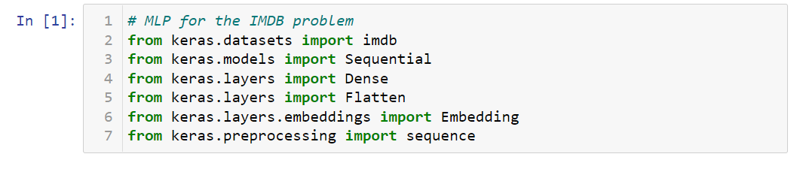
Import Libraries

Slide 11
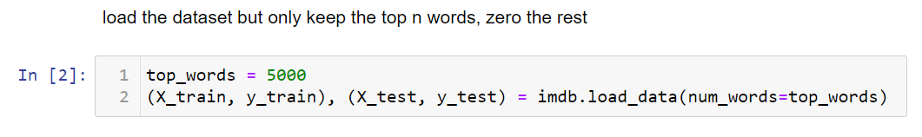
Load and Split Dataset in Training and Testing Data
Notes:
The words have been replaced by integers that indicate the absolute popularity of the word in the dataset. The sentences in each review are therefore comprised of a sequence of integers.
Calling imdb.load_data() the first time will download the IMDB dataset to your computer and store it in your home directory under ~/.keras/datasets/imdb.pkl as a 32 megabyte file.
Usefully, the imdb.load_data() provides additional arguments including the number of top words to load (where words with a lower integer are marked as zero in the returned data), the number of top words to skip (to avoid the “the”‘s) and the maximum length of reviews to support.

Slide 12
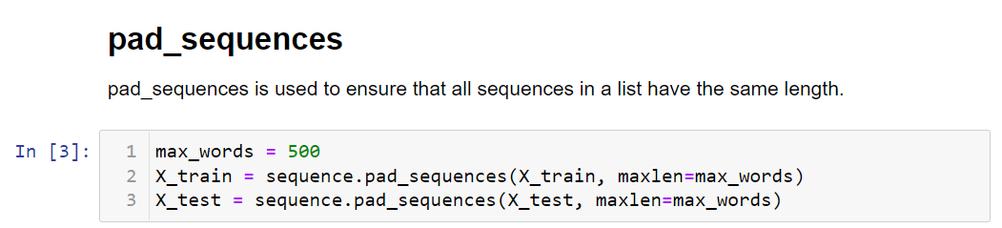
Pre Processing

Slide 13
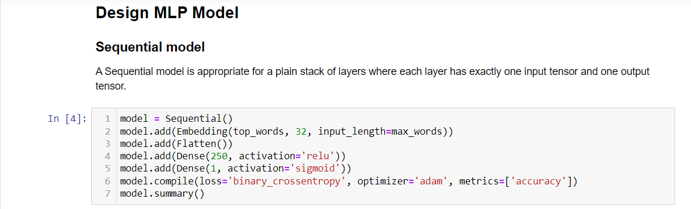
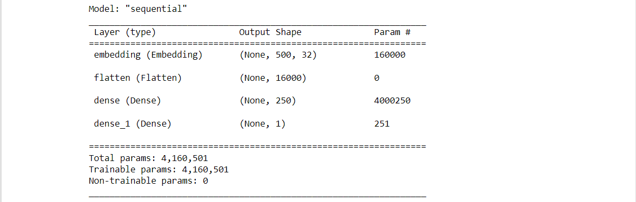

Slide 14
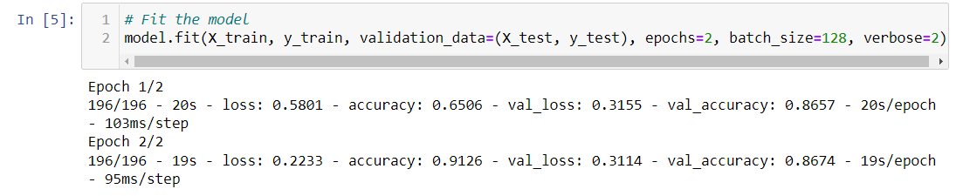
Fit the Model

Slide 15
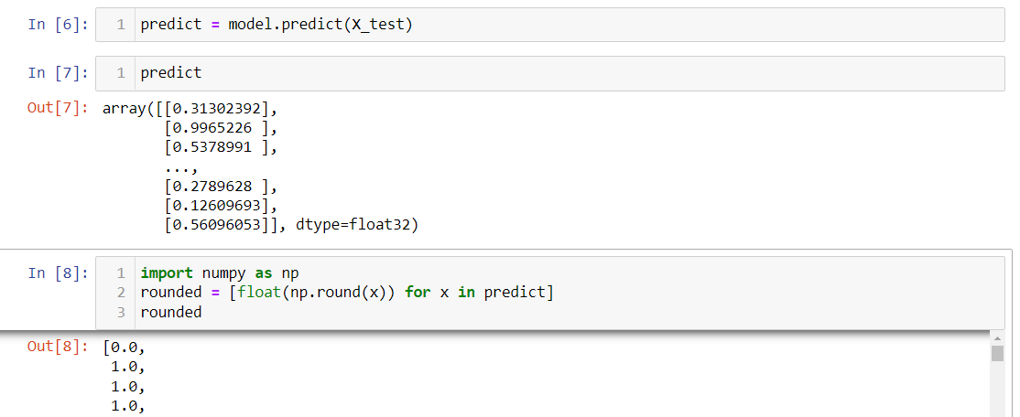
Predict the Model

Slide 16
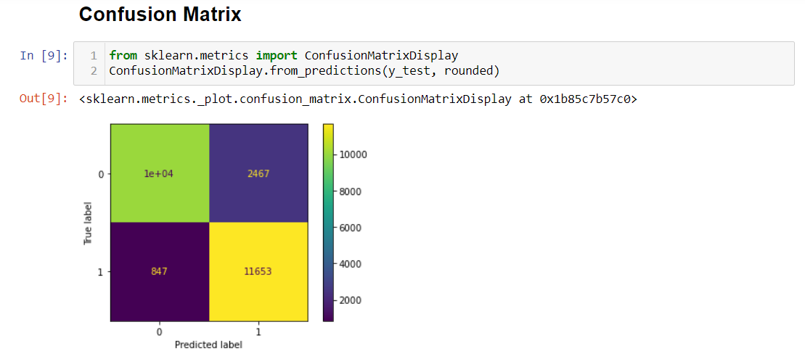
Result

Slide 17
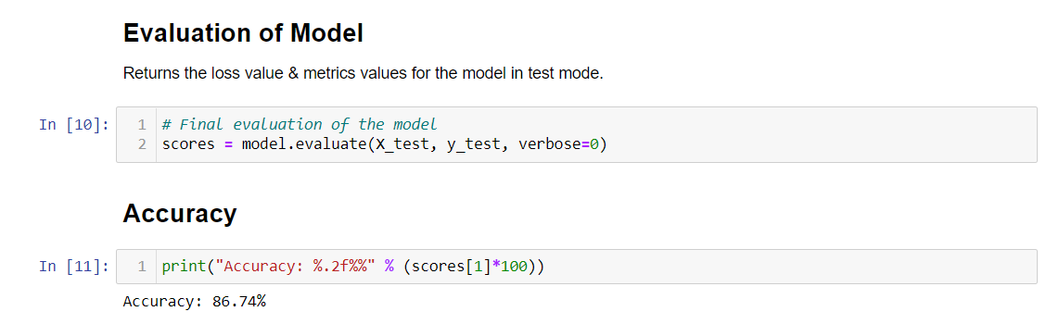
Evaluation

Slide 18


